Slide 1
Marketing and Retail Analytics project report
By: Ambrish Verma
Date: 6-April-2024

Slide 2
Project 1 – RFM Analytics
Problem Statement:
An automobile parts manufacturing company has collected data on transactions for 3 years. They do not have any in-house data science team, thus they have hired you as their consultant. Your job is to use your data science skills to find the underlying buying patterns of the customers, provide the company with suitable insights about their customers, and recommend customized marketing strategies for different segments of customers.

Slide 3
Part A – Automobiles Sales Data
Data Summary:
There are a total of 2747 records and 20 attributes in the data report.
There are no missing value in the records for any of the attributes.
The information of the data attributes:
Column | Count | Non-null | Data type
ORDERNUMBER | 2747 | non-null | int64
QUANTITYORDERED | 2747 | non-null | int64
PRICEEACH | 2747 | non-null | float64
ORDERLINENUMBER | 2747 | non-null | int64
SALES | 2747 | non-null | float64
ORDERDATE | 2747 | non-null | datetime64[ns]
DAYS_SINCE_LASTORDER | 2747 | non-null | int64
STATUS | 2747 | non-null | object
PRODUCTLINE | 2747 | non-null | object
MSRP | 2747 | non-null | int64
PRODUCTCODE | 2747 | non-null | object
CUSTOMERNAME | 2747 | non-null | object
PHONE | 2747 | non-null | object
ADDRESSLINE1 | 2747 | non-null | object
CITY | 2747 | non-null | object
POSTALCODE | 2747 | non-null | object
COUNTRY | 2747 | non-null | object
CONTACTLASTNAME | 2747 | non-null | object
CONTACTFIRSTNAME | 2747 | non-null | object
DEALSIZE | 2747 | non-null | object

Slide 4
Data Summary - Continued
First order date: 2018-01-06
Report generation date: 2020-06-01
No anomaly in customer details. All the data in the attributes: Phone, Address attributes are linked to the customer's name.
Total 89 different customers exist.
118 orders have status of: ‘Cancelled’, ‘On-hold’, and ‘Disputed’. These are from a total of 10 customers.
It is assumed that if the attribute: ‘PRICEEACH’ is higher than or equal to ‘MSRP’, the sale is profitable, else it is loss-making.

Slide 5
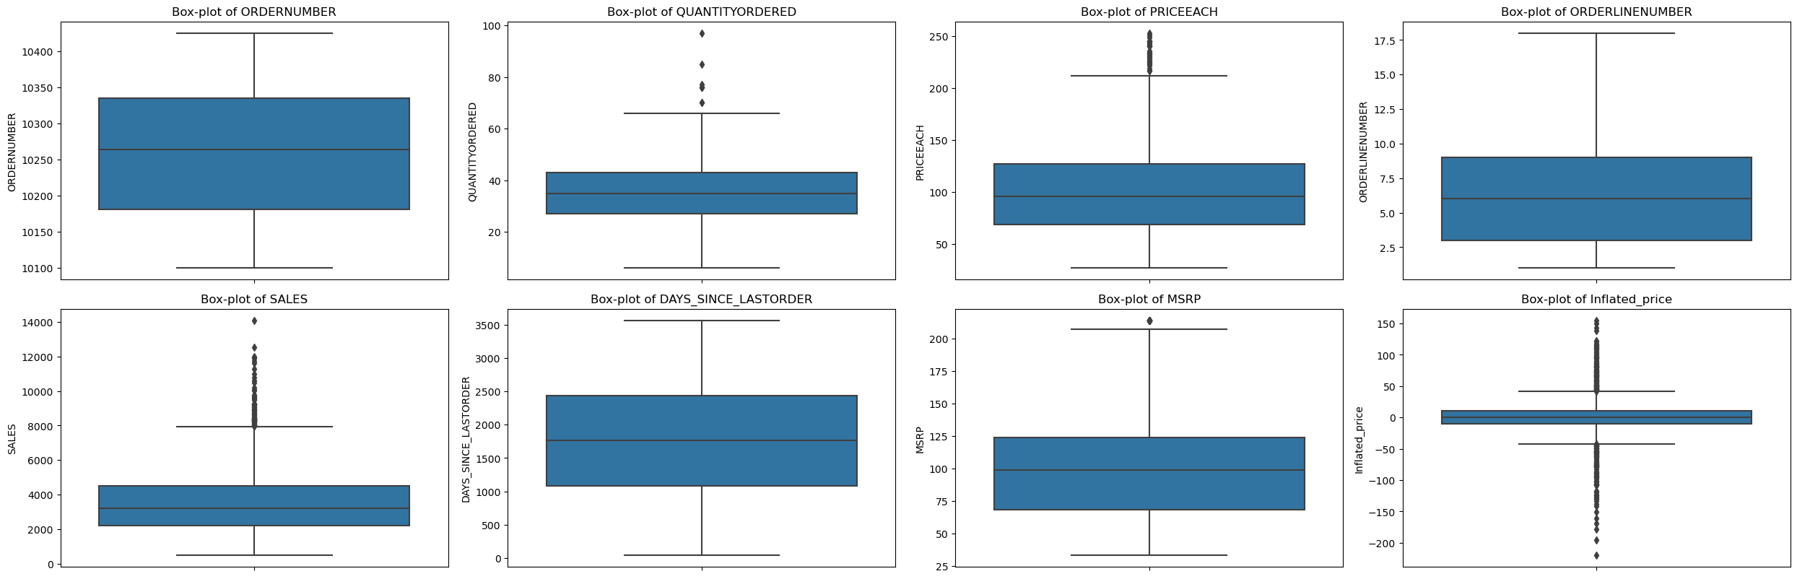
Exploratory Data Analysis – Univariate Analysis of Numeric Attributes
The inflated price is a derived column by subtracting PRICEEACH from MSRP
Most orders have number of each item within the range 3-9
The difference between MSRP and PRICEEACH have significant outliers. Hence, the MSRP is not strictly followed.

Slide 6
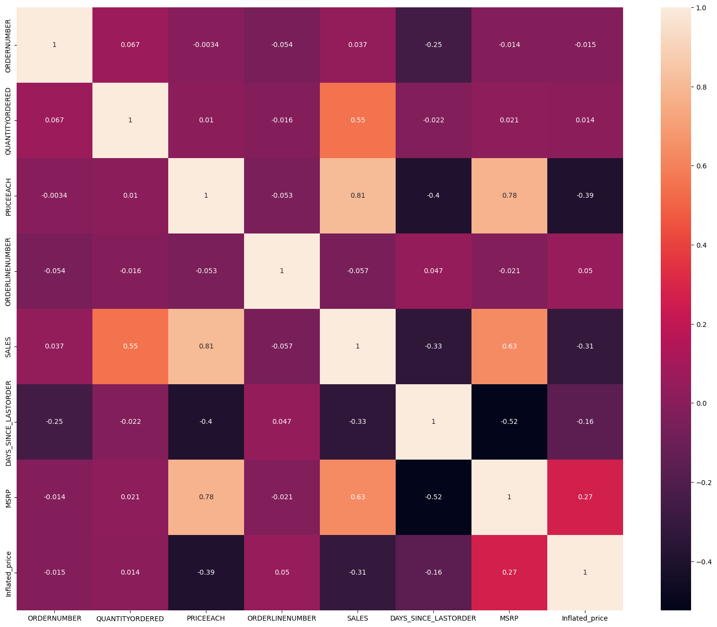
Bivariate Analysis – Numeric Columns
DAYS_SINCE_LAST_ORDER has negatively correlated With SALES. This is in line with the assumption that customer who has ordered long back is not contributing to sales.
MSRP and PRICEEACH are highly positively correlated with SALES.
QUANTITYORDERED is positively correlated with SALES. Hence, more the quantity more the SALES.

Slide 7
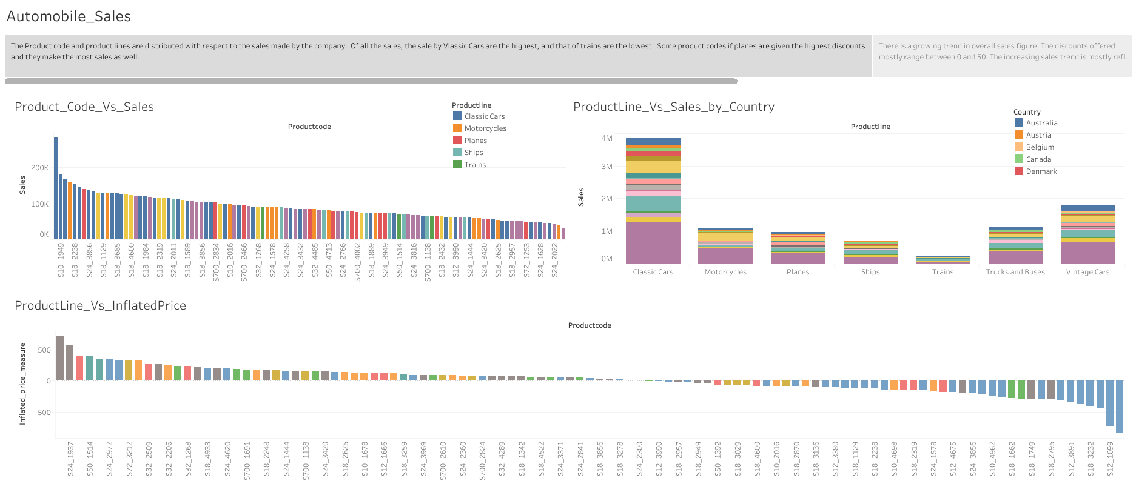

Slide 8
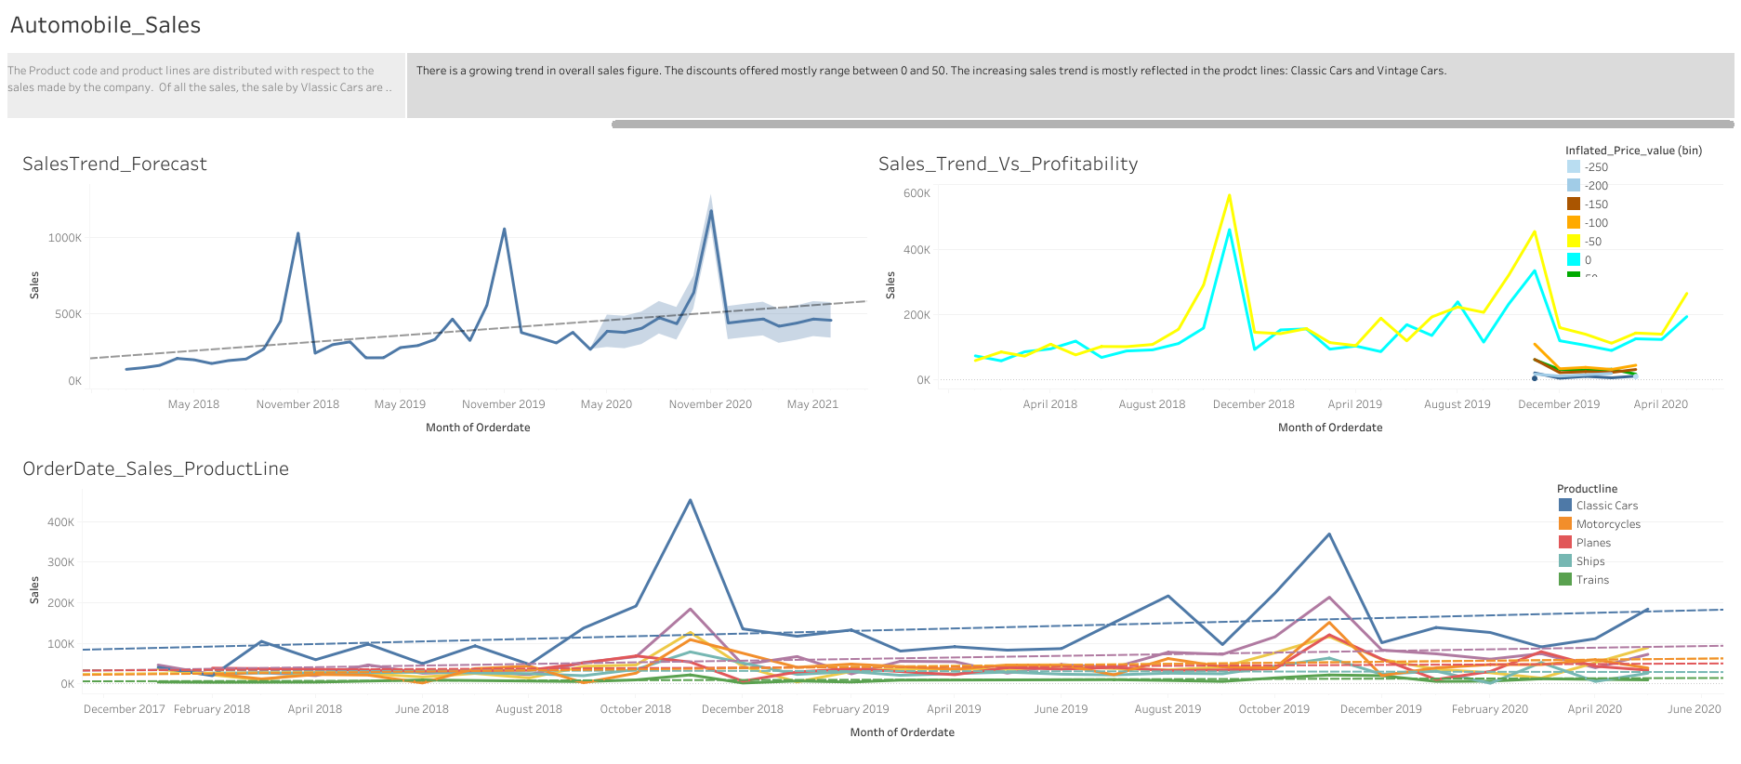

Slide 9
EDA – Multivariate Analysis
There is a growing trend in overall sales figure.
The discounts offered mostly range between 0 and 50.
The increasing sales trend is mostly reflected in the product lines: Classic Cars and Vintage Cars
The Product code and product lines are distributed with respect to the sales made by the company.
Of all the sales, the sale by Classic Cars are the highest, and that of trains are the lowest.
Some product codes if planes are given the highest discounts and they make the most sales as well.

Slide 10
RFM Analysis
Recency Frequency Monetary Analysis is the analysis of customer transactional behaviour to understand how important the customer is for the seller.
Recency tells when was the last time the customer transacted. Frequency is about the quantity of order and Monetary tells us about the total sale amount the customer gave the seller.
In the current problem, the assumptions made are:
DAYS_SINCE_LASTORDER denotes the recency
Total Count of ORDERNUMBER per customer is for frequency
SALES column is the monetary field that can be used for RFM analysis
The above columns were then validated using the other available attributes and were found to be correct.
For better readability, the following changes were made to the column names:
SALES → Monetary
DAYS_SINCE_LAST_ORDER → Recency
The data was grouped on Customer Name and the bins were then created for Recency, Frequency and Monetary.
The bins were converted in the following manner:
Quantile | Bin | F, M Values | R Value
0.0 - 0.25 | Bin 1 | 1 | 4
0.25 - 0.5 | Bin 2 | 2 | 3
0.5 - 0.75 | Bin 3 | 3 | 2
0.75 - 1 | Bin 4 | 4 | 1

Slide 11
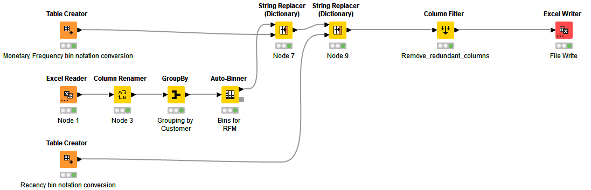
Knime Workflow:
The workflow steps are:
The dataset is read using the node: Excel Reader. For better readability, the Columns are renamed as mentioned in previous slide.
The data is grouped using groupby node to group them based on customer name
The grouped data are then converted into Bins. Ex: Bin 1, Bin2 etc. based on the quantile values.
The bins are then converted again to the codes: 1,2,3,4 with 1 being the lowest/poorest and 4 being the highest.
The final file has the RFM bins along with the customer names to identify which is our best customer and which are the ones who can be dropped.

Slide 12
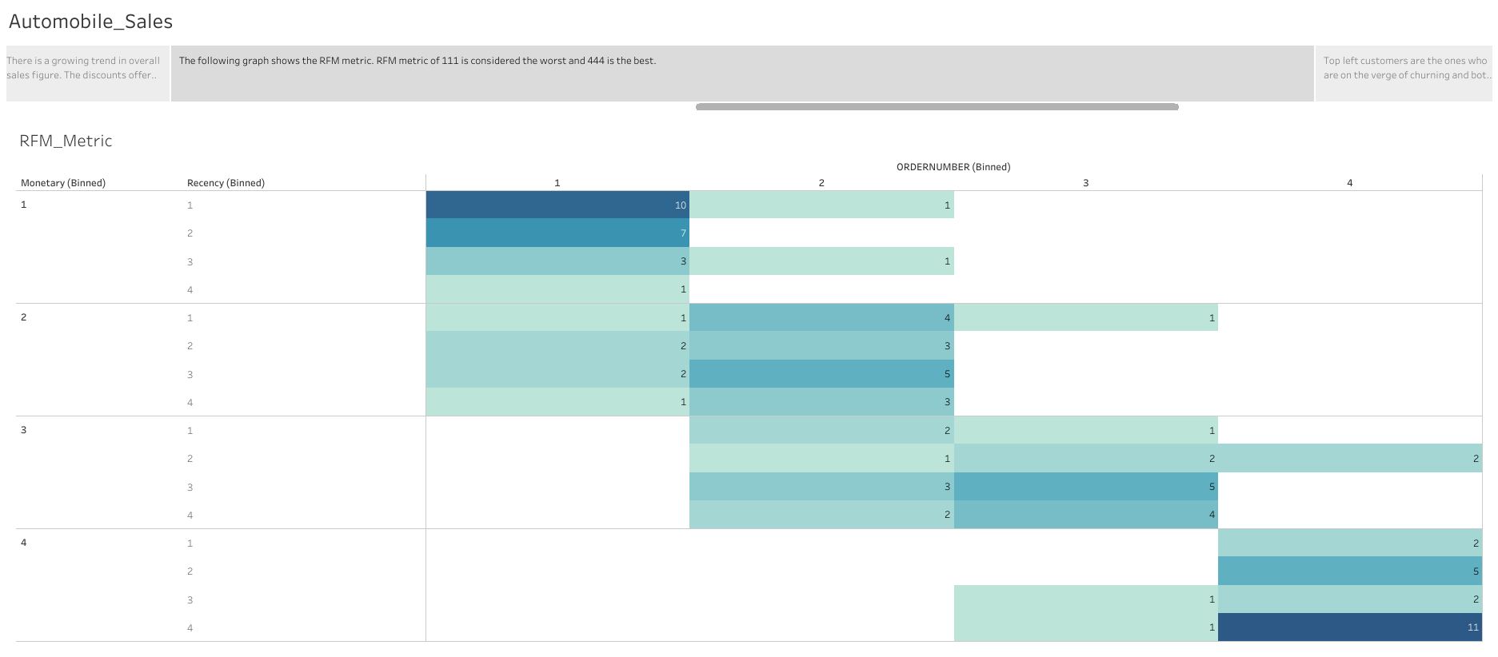

Slide 13
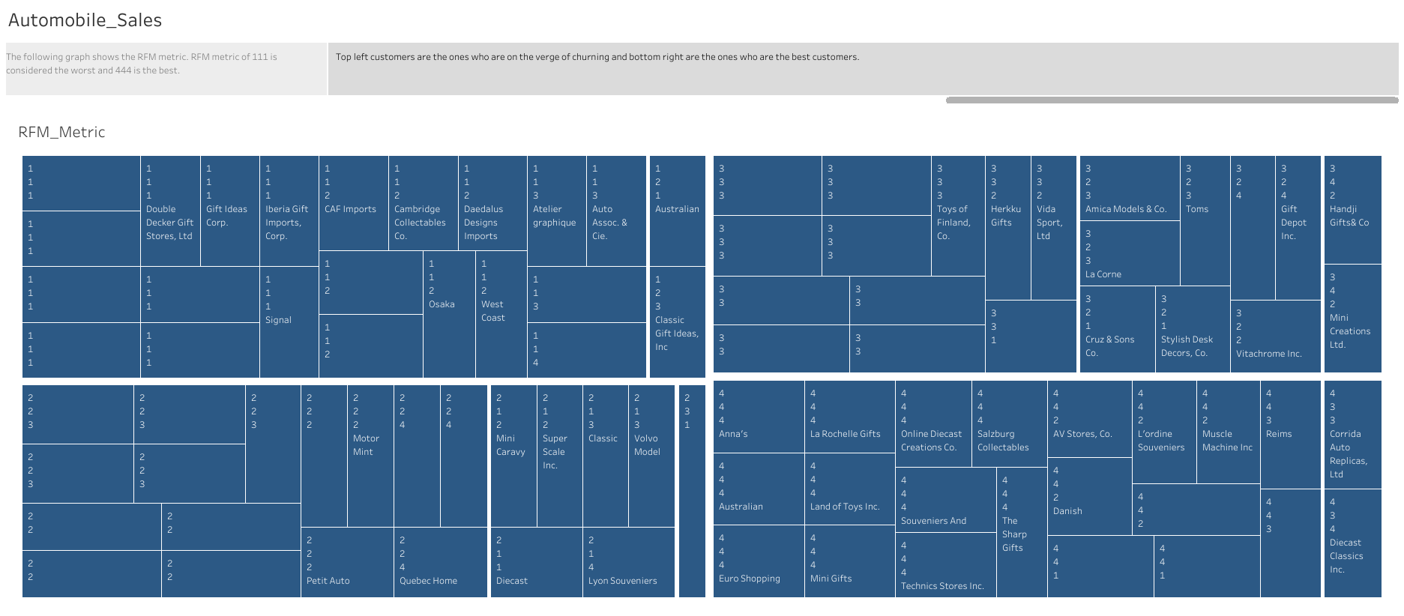

Slide 14

RFM Analysis – outcome 1
Based on the bins, the best customers were identified as those who had the score of 444.
The lost customer were identified as those who had a score of 111
The best customers:
Anna's Decorations, Ltd
Australian Collectors, Co.
Euro Shopping Channel
La Rochelle Gifts
Land of Toys Inc.
Mini Gifts Distributors Ltd.
Online Diecast Creations Co.
Salzburg Collectables
Souveniers And Things Co.
Technics Stores Inc.
The Sharp Gifts Warehouse
The lost Customers:
Alpha Cognac
Auto-Moto Classics Inc.
Bavarian Collectables Imports, Co.
Clover Collections, Co.
Double Decker Gift Stores, Ltd
Gift Ideas Corp.
Iberia Gift Imports, Corp.
Mini Auto Werke
Royale Belge
Signal Collectibles Ltd.

Slide 15

RFM Analysis – outcome 2
Based on the bins, the Loyal customers were identified as those who had the score of 4 for Frequency(ORDERNUMBER)
The customer who were identified to be on the verge of churning were from the group having RFM score of as those who had a score of 333, 342, 334. (Sum of RFM scores 9 or 10)
The Loyal customers
Dragon Souveniers, Ltd.
Customers on the verge of churning:
Heintze Collectables
Rovelli Gifts
Handji Gifts& Co
Mini Creations Ltd.
AV Stores, Co.
Danish Wholesale Imports
L'ordine Souveniers
Muscle Machine Inc
Saveley & Henriot, Co.
Reims Collectables
Scandinavian Gift Ideas
Anna's Decorations, Ltd
Australian Collectors, Co.
Euro Shopping Channel
La Rochelle Gifts
Land of Toys Inc.
Mini Gifts Distributors Ltd.
Online Diecast Creations Co.
Salzburg Collectables
Souveniers And Things Co.
Technics Stores Inc.
The Sharp Gifts Warehouse
Marta’s replicas Co.
Souminen Souveniers
Tokyo Collectables, Ltd
Toys of Finland, Co.
Auto Canal Petit
Baane Mini Imports
Oulu Toy Supplies, Inc.
UK Collectables, Ltd
Handji Gifts& Co
Mini Creations Ltd.

Slide 16
Project 2 – Market Basket Analysis
Problem Statement:
A grocery store shared the transactional data with you. Your job is to conduct a thorough analysis of Point of Sale (POS) data, identify the most commonly occurring sets of items in the customer orders, and provide recommendations through which a grocery store can increase its revenue by popular combo offers & discounts for customers.

Slide 17
Exploratory data Analysis
Data Summary:
There are a total of 20641 records and 2 attributes in the dataset provided.
The attributes and data-types provided are:
A Total of 37 products of different categories are sold at the store.
The dataset does not have a continuous data available for a thorough time-series analysis.
# | Column | Non-Null | Count | Dtype
0 | Order_id | 20641 | Non-Null | Int64
1 | Product | 20641 | Non-Null | object

Slide 18
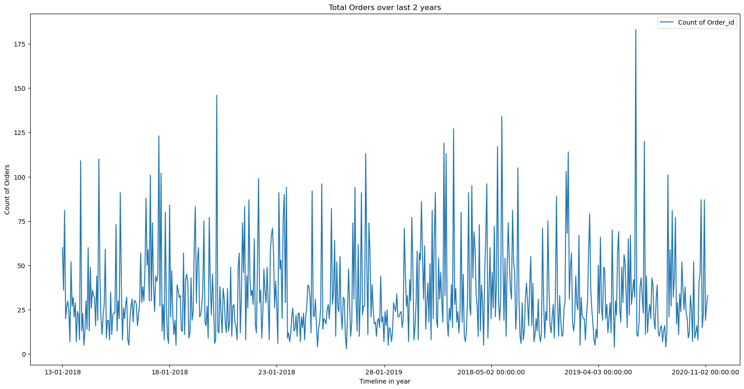
Order trend – day wise

Slide 19
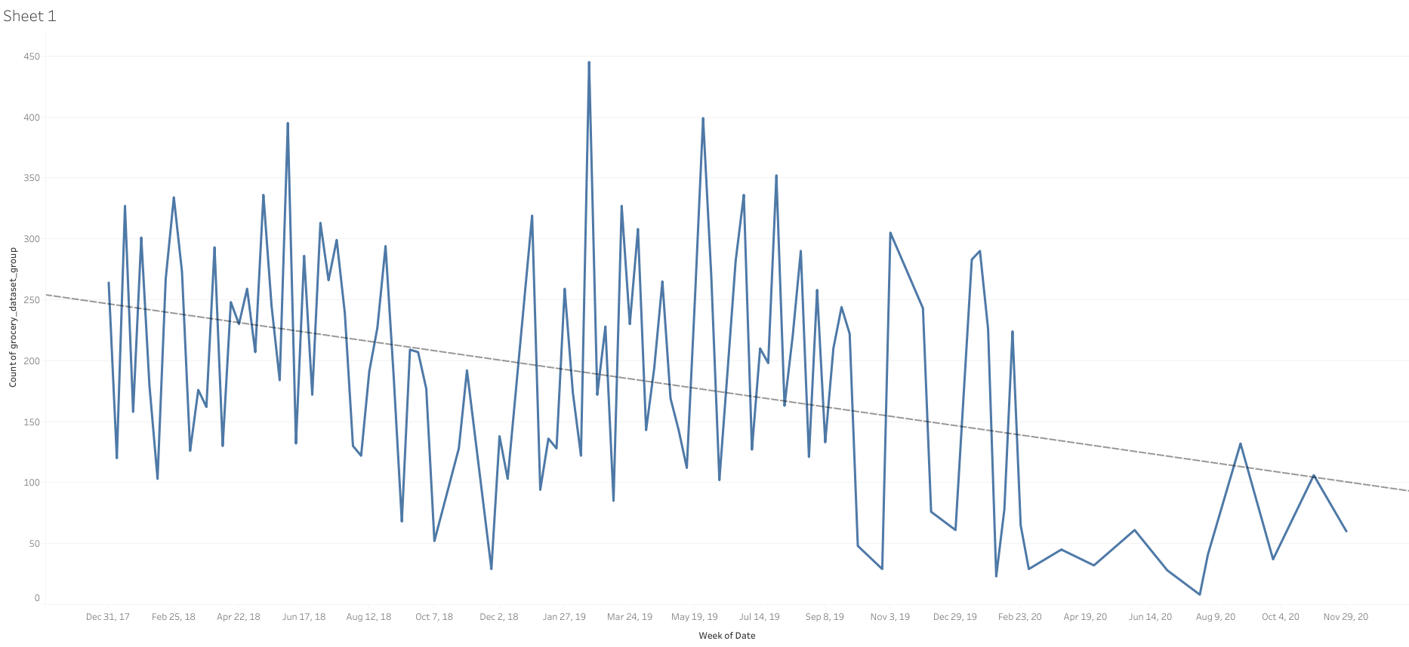
Order trend - monthly
Downward trend of the number of orders can be observed.

Slide 20
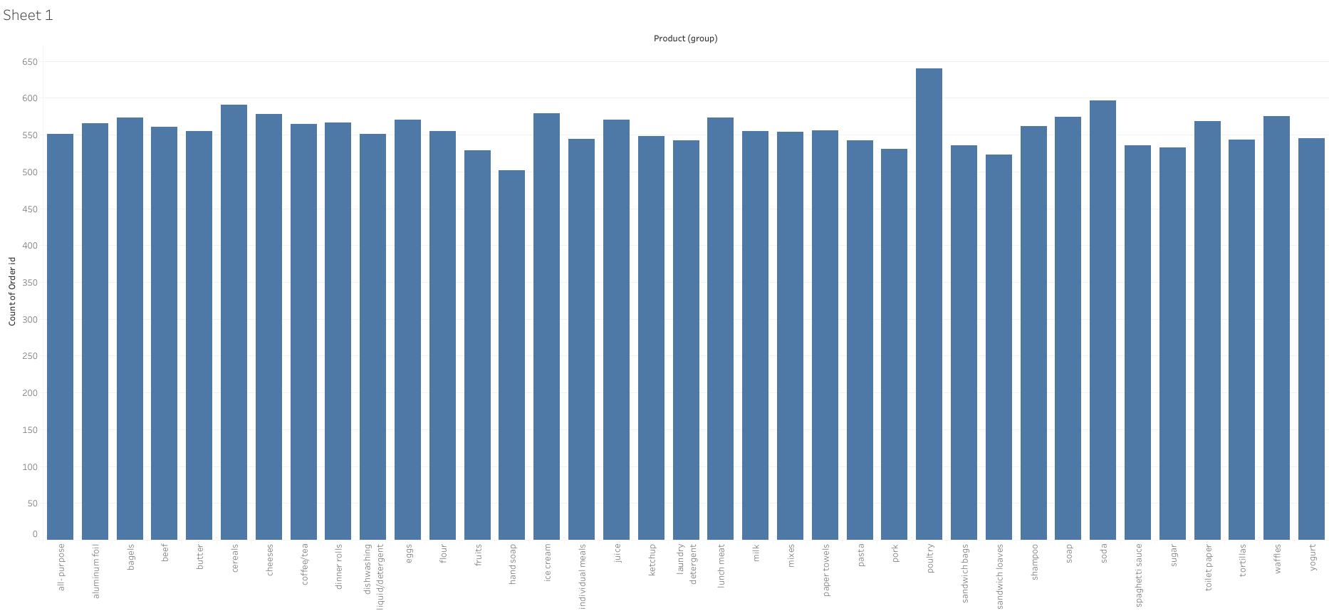
Count plot – Product group

Slide 21
Market Basket Analysis – Grocery Order data
For the problem, the MBA is done using KNIME tool.
The steps for MBA using KNIME are explained below:
The dataset was read using the CSV reader node.
This dataset was then grouped using the order_id as an input for the next node: cell_splitter.
In the cell_splitter, lists of products was generated.
The node ‘Association Rule Learner was used to create the associations.
Minimum support value = 0.03 has been configured. Support value is a measure of how often an itemset appears in the transactions relative to the total transactions.
Minimum confidence of 0.6 has been configured. Confidence measures the likelihood that if item A is purchased, item B will also be purchased.

Slide 22
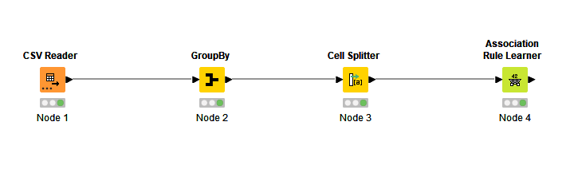
Knime workflow

Slide 23
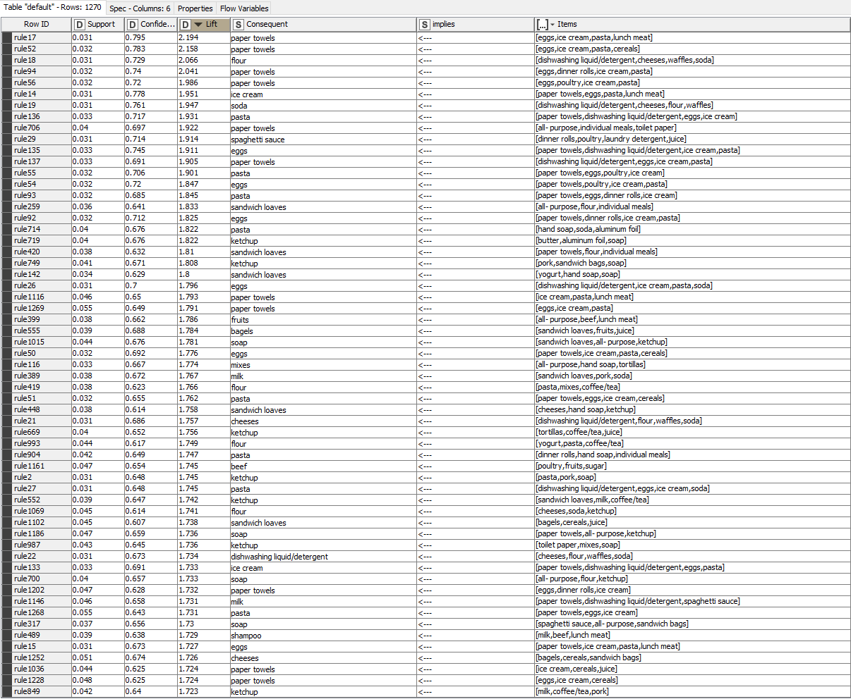
MBA recommendation table (snippet).

Slide 24
Explanations of the recommendation table:
The Column Items is the list of the products that are ordered.
Market Basket Analysis recommends the items in the field ‘Consequent’ .
Lift signifies the chances of the customer buying the consequent item if s/he has bought the items in the ‘Item’ bucket.
Ex: For the first row, the chances of the customer buying the item: ‘paper towels’ are higher by 2.194 times if s/he has bought the items as mentioned in the column: ‘Item’.
The support for this row is 0.031. This means that for the items in this bucket(e.g. egg, the number of transactions containing egg /total number of transactions = 0.031)
Confidence for the first row is 0.795 indicates that there is 79.5% probability that if the customer has bought egg, ice cream, pasta, lunch meat, then s/he will purchase paper towel as well.

Slide 25
Suggestions
Paper towels, eggs, ice cream, soda, pasta are among the most prominent recommendations in the analysis. Hence, these items should be placed very near to the billing counter.
Also, for the above, giving a discount on the above group of items also will entice the customers to add the additional items for purchase/ Ex: Egg and paper towel can be used for a combo offer.
Sandwich loaves are the item of choice for customers wo are buying the individual meals. Hence, giving a discount on sandwich loaves when one buys individual meals is a good recommendation.

